Slide 1
Scrambler Password
Team 13
Daniel Rochefort
Doehoon Kim
Maxwell Warncke
Richmond Azumah

Slide 2

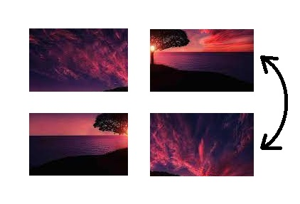
What is Scrambler Password?
Notes:
scrambler password

Slide 3
Purpose
A different and potentially more secure method for a user to login to a website
Users are able to sign up or login
Users select a provided image that is then separated into 9 squares
The movement of these squares, the scrambling, is the user’s password
9! (362880) available password combinations
Created for web platform environment

Slide 4
Tech Platform
Front End:
Next.js
HTML
CSS
Back End:
Next.js
Firebase Hosting
Firebase Realtime Database
Firebase Cloud FireStore
Notes:
FireBase Realtime Database: NoSQL database with data stored as json
FireBase Cloud FireStore: NoSQL database with data stored in documents

Slide 5
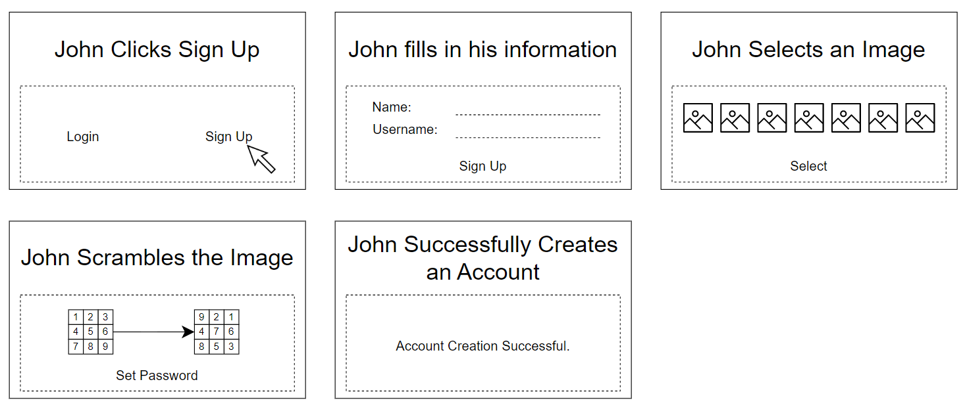
New User Story Board

Slide 6
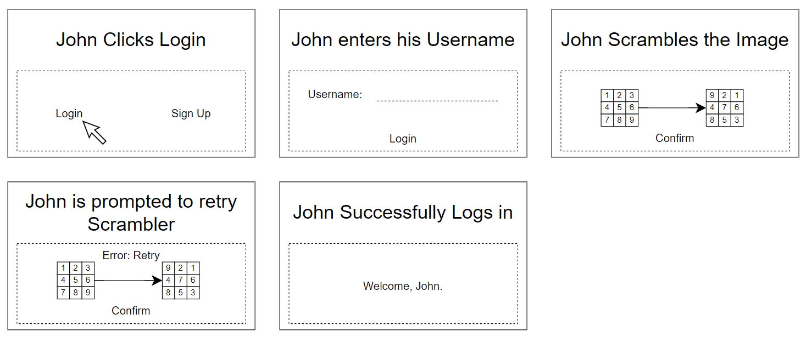
Existing User Story Board

